Slide 1



Azure API Management
A Beginners guide to Azure API Management
Mandar Dharmadhikari

Slide 2




Who am I?
mandardhikari
@theabodeofcode
Technical Consultant at Chamonix IT Consulting Pty Ltd, Adelaide, South Australia
Integration and AI enthusiast
TechNet Wiki Ninja and Author
Blogger at https://www.theabodeofcode.com
Die Hard Metallica, Dragon Ball and GOT fan
Budding cook
https://au.linkedin.com/in/mandar-dharmadhikari

Slide 3
Takeaways from the session
What is Azure API Management
Why Use it?
Understand Basic Concepts of APIM
Products and Subscriptions
Polices in Azure API Management
Developer Portal

Slide 4
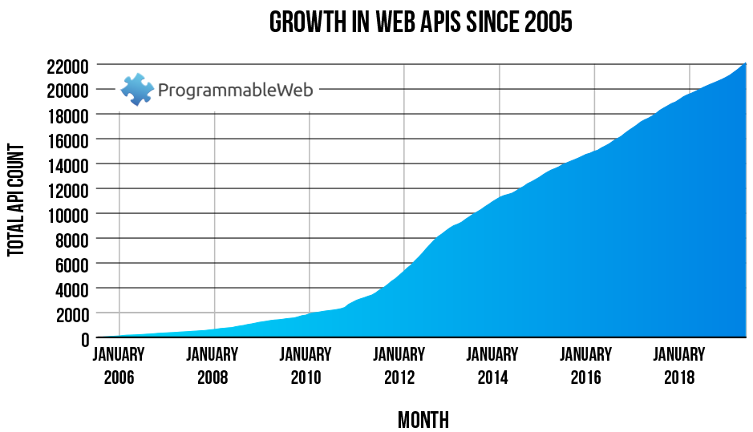
What are Web APIs
Web APIs are the Application Programming Interfaces exposed as services exposed over HTTP
Encapsulate the logic to communicate with backend
Standard way to expose functionality to external and internal users
Easy to use

Slide 5

API Life Cycle
Plan
Retire
Design
Expose
Develop
Deploy
Test

Slide 6
Typical web API consumers
Internal Users
Partners
External World

Slide 7
API Management Life Cycle
Create
Revise
Secure
API
Configure
&
Manage
Analyse
Monetize
Socialize

Slide 8
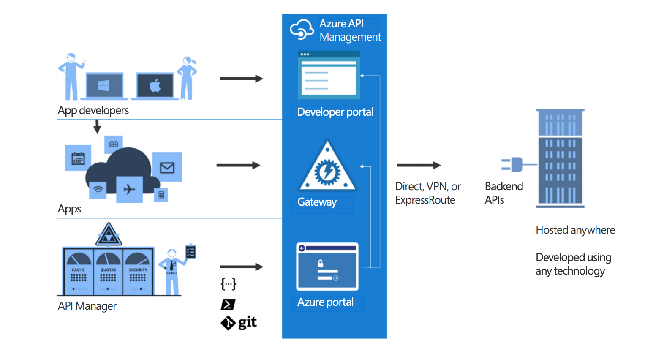
Azure API Management

Slide 9
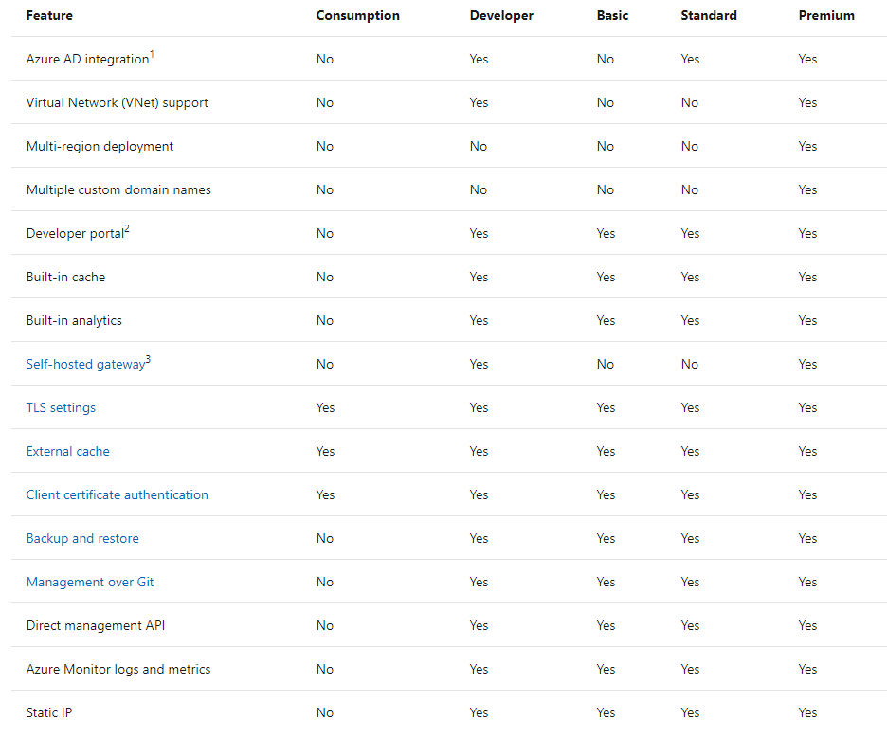
Azure API Management Tiers

Slide 10
Terminology
Term | Meaning
Backend API | The API residing in the backend which contains the business logic and integration
Frontend API | The façade created & exposed by APIM
Product | Container to bundle API and implement terms of use
Operation | Individual operation in front end API corresponding to a backend resource
Version | Version of the facades exposed by APIM
Revision | Changes made to a published API
Dev Portal | Portal to access APIs and doco by the consumers

Slide 11

Products
Bundle APIs together for consumers
Implement Terms of Use on the bundle
Set Quotas on the API consumption
Allow specific groups to subscribe to a bundle in one go

Slide 12

Subscriptions
Mechanism to restrict access to the APIs
Allows developers to subscribe and use the APIs in portal or in their code
Three level of scopes
Product
Individual API
All APIs

Slide 13
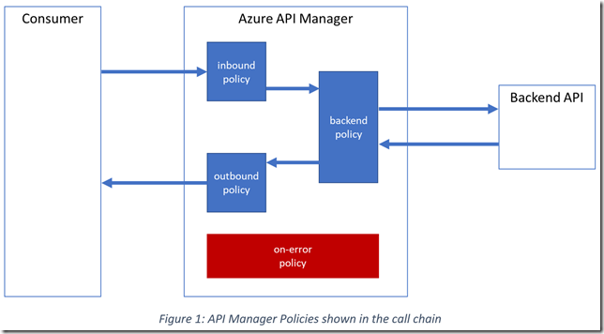
Policies
Mechanism to alter API behaviour using configuration
Authentication policies
Restriction policies
Transformation polices
Four level of scopes for policies(deterministic sequential execution with relation to <base/> element)
Global
Product
Individual API
Individual operation

Slide 14
A look at Developer Portal

Slide 15
Reading Source
https://azure.github.io/api-management-resources/

Slide 16



Slide 17
mandardhikari
@theabodeofcode
Contact Me
https://au.linkedin.com/in/mandar-dharmadhikari
www.theabodeofcode.com

